Slide 1

Have you ever imagined yourself with a missing arm or a leg or any of the five senses ?

Slide 2
Do you feel lucky for having a perfect and ideal human body ?

Slide 3
But not every one of us is so lucky to have a perfect body to possess…

Slide 4
Oculus Sinister (left eye) [ Moksh Nigam, Divya Gupta ] # Sign_Language_interpreter #

Slide 5





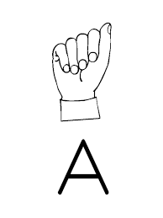






Slide 6
Reasons why Sign language interpreter was chosen : - to give people with disabilities who deserve a comfortable communication with others. - to replace sign language manual. - to train our modes of communications viz: cell phones for some real communication with such people. - to make our machines understand to what can’t be heard or understand unspoken words that also have meanings too

Slide 7
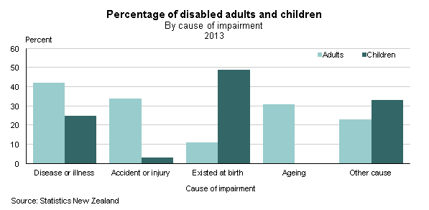
Statistics ->

Slide 8

Some struggles in the life of deaf people =>

Slide 9
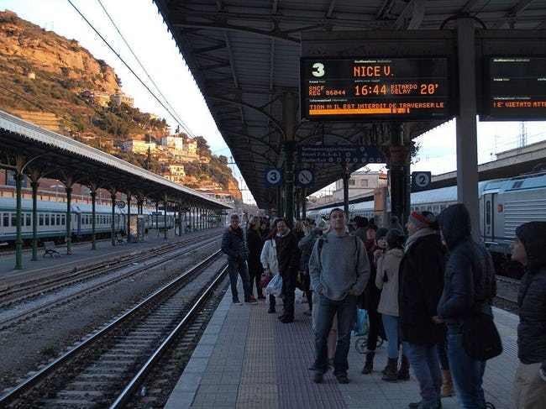
Not Getting Announcements At Public Places And Events,

Slide 10
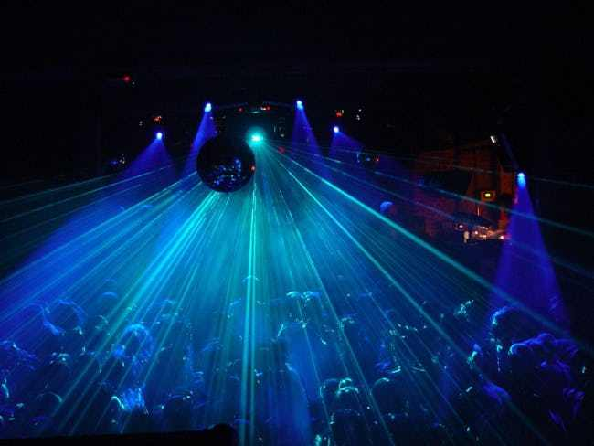

Communicating In The Dark Is Next To Impossible

Slide 11
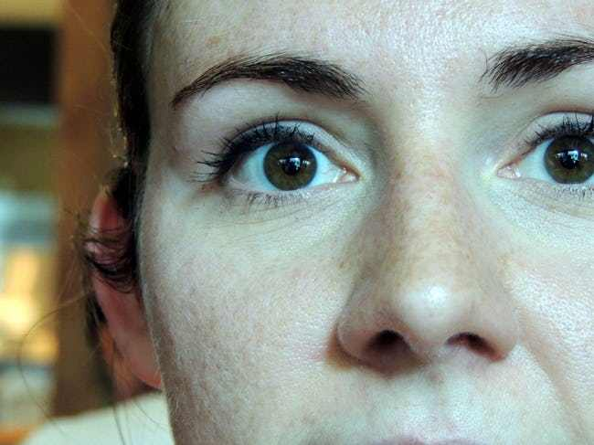
You're Constantly Jumpy, As You Never Know When Someone Is Approaching You From Behind

Slide 12
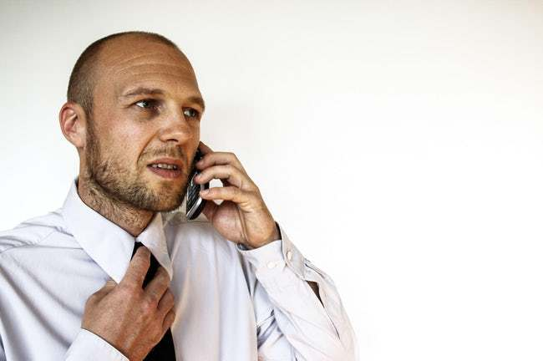
Job Applications And Interviews Can Be Incredibly Difficult To Set Up

Slide 13

Having People Avoid Talking To Them At All

Slide 14
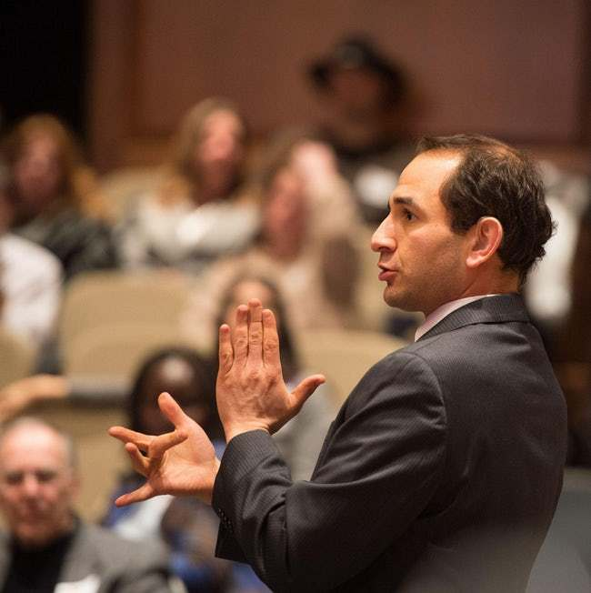

The Hearing Population Feels Sorry For You, And You Don't Need Their Sympathy

Slide 15
But for all these struggles…

Slide 16

We give you a model of classification which is capable of identifying the alphabets in a sign language of handicap people. That model for now can understand alphabets like A, B, C,V. Make a point in the conversation. And numeral 5. In the future this model will be super useful because it can help everyone to understand people who are lacking the power of hearing or speaking.

Slide 17
Sign Language Interpreter Working
Works on Convolutional Neural Network
Image Processing
Pattern Detection
Maxpool fully connected layer
Activation Function
(eg- ReLU, Sigmoid , tanh)
Through Convolution
Layers

Slide 18
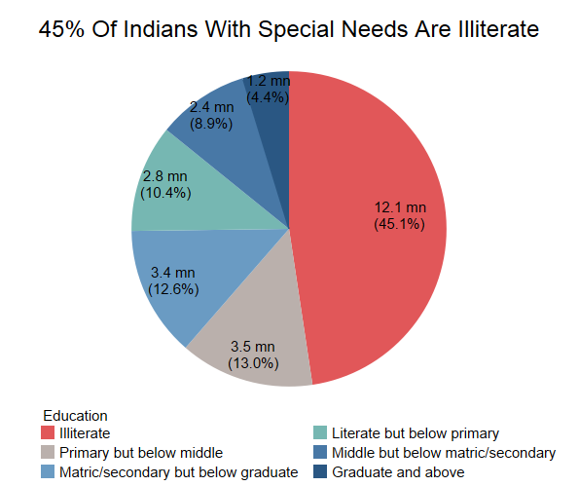
Target Audience
2.21% of the Indian Population is disabled
Language in which they communicate is sign language
For which they will use sign language interpreter

Slide 19
Reaching The Common People via ->
https://github.com/Altruist13/Sign-Language/blob/master/Sign_Language_Classifier_new.py
Afterwards – web-app
Market
for
Product
Google , Uber , OYO , Restaurants , Hotels ,Phonak

Slide 20

Convolutional Neural Network

Slide 21
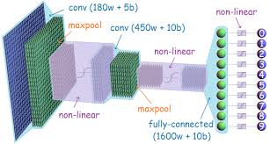
Conv layer, maxpool, conv layer, maxpool, fully connected,

Slide 22


Slide 23
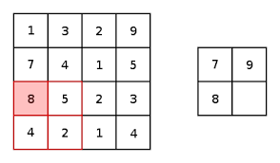

Slide 24
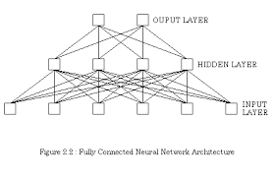

Slide 25
Situations with them can always be mended, its despicable of leaving that part of human species behind, we should always try to create ways to better others with zero selfish thoughts,

Slide 26
THANK YOU

